Slide 1
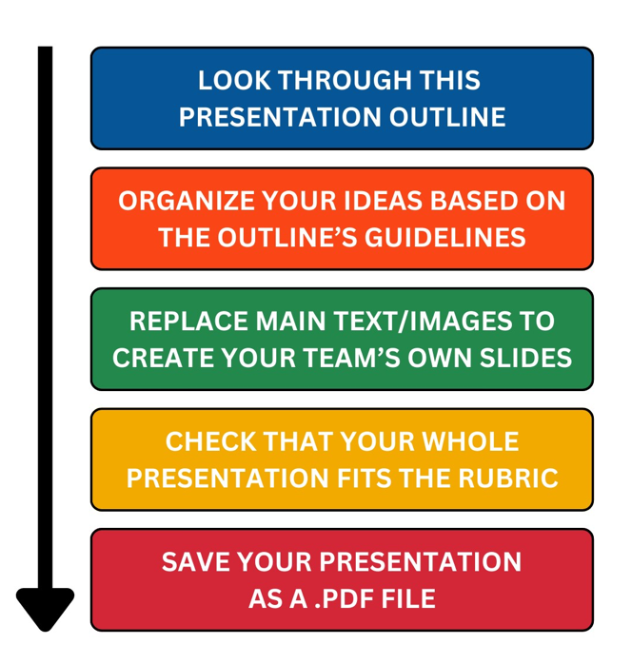
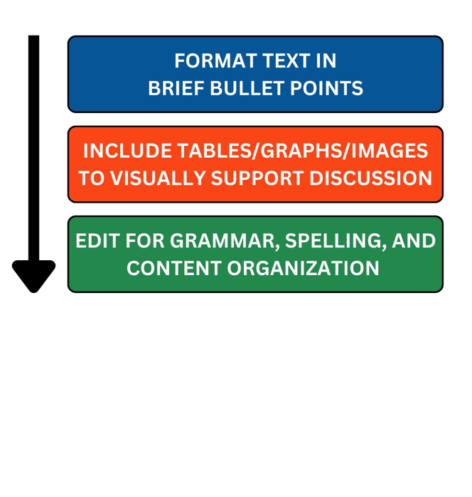
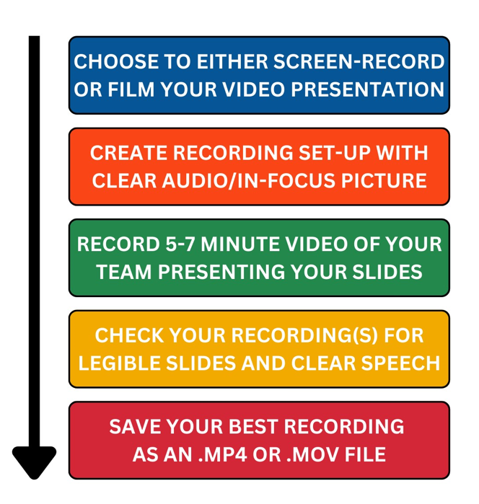
Presentation Guidelines and Reminders
Use this outline to create presentation slides for your smart energy management system design.
FOR YOUR PRESENTATION:
REMEMBER TO:
FOR YOUR VIDEO:

Slide 2
Presentation Title
Team Name
Team Members’ Names
School

Slide 3
Introduction
Introduce the purpose of the design project and explain your main design goals.

Slide 4
Introduction
Give the audience an overview of the steps you will be presenting that helped you create your design.
Use bullet points or images to summarize different parts of the whole presentation.

Slide 5
Introduction
Provide Introduction
  Purpose and Goals
  Presentation Overview
Explain Background
  Power Usage and Energy Consumption
  Power Optimization and Energy Management
  Artificial Intelligence
Discuss Home Devices
  Inventory
  Collected Data
Discuss Selected Scenario
Explain Scenario Conditions

Slide 6
Power and Energy Use
Provide any necessary vocabulary/background information.
For example, you could explain how the following terms relate to your project by answering certain questions:
  Power
    What is power?
    What are power monitors?
  Energy Use
    What is energy?
    How much energy does the typical Florida resident use in a month?
    How much does that cost?
    Use images to demonstrate different concepts!

Slide 7
Power Optimization and Energy Management
Provide any necessary vocabulary/background information.
For example, you could explain how the following terms relate to your project by answering certain questions:
  Power Optimization
    What is power optimization?
    How can you optimize power use in your home?
  Energy Management
    What is energy management?
    What are some ways that energy can be managed?
    What are some examples of smart devices?
      Use images to demonstrate different concepts!

Slide 8
Artificial Intelligence
Provide any necessary vocabulary/background information.
For example, you could explain how the following terms relate to your project by answering certain questions:
  Artificial Intelligence
    What is the Internet of Things (IoT)?
    Why would IoT be helpful when using AI for household power optimization?
      Use images to demonstrate different concepts!

Slide 9
Home Device Inventory
Provide a table and/or images that show the devices you chose.
Discuss why you chose these devices.
Table 1: Inventory of Home Devices
Device Name

Slide 10
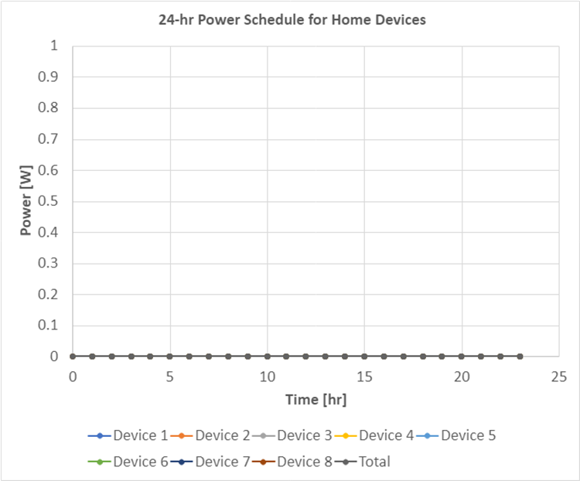
Home Device Data
Insert the graph of your initial power schedule.
Discuss how your different devices performed.
  Which of your devices operated most often?
  Which of your devices used the most power?
  When were most devices used and not used?
  How did different operating times contribute to your total power usage?
  Which of your devices consumed the most energy?

Slide 11
Selected Scenario
Discuss your selected scenario and why you chose it.
Explain how the data you analyzed affected the new power schedule goals that you created for your specific scenario.
  How did you create changes in your power usage and energy consumption?
  Which devices did you need to change?

Slide 12

Selected Scenario
Fill this slide with the graph of your new power schedule.
Discuss how different parts of your initial graph changed.
Discuss what the changes mean in relationship to your scenario.

Slide 13
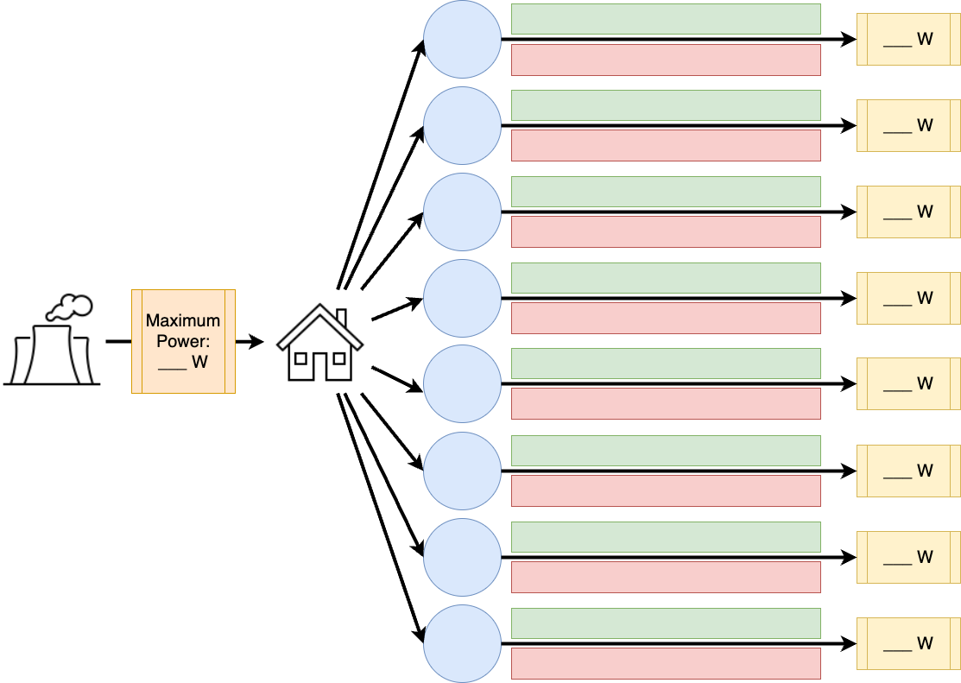
Modeling Scenario Conditions
Replace this flow diagram model with your own.
Discuss why you designed your flow diagram this way.

Slide 14
Modeling Scenario Conditions
Discuss the conditions you created for your smart energy management design.
  How do your conditions relate to the changes you achieved in your graph?
  How do these conditions help AI make sure your smart energy management system works during your scenario?

Slide 15
References
Don’t forget to properly label and cite your tables, figures, and references, as outlined in the Executive Summary!
IEEE Citation Example:
  [1] IEEE. IEEE Reference Guide, V 11.29.2023. (2023). [Online]. Available:
  https://journals.ieeeauthorcenter.ieee.org/wp-content/uploads/sites/7/IEEE_Reference_Guide.pdf

Slide 16
Thank you!

